Slide 1
ONLINE DOCUMENT DISSEMINATION
An Online Document Dissemination for West Visayas State University Medical Center

Slide 2
INTRODUCTION
A web-based system that will manage communication documents within an organization through a centralized document repository.
Can track effectively and efficiently all communication documents such as: Memorandum, Circulars, Administrative Order, etc.
A browser based application that can be accessed by all offices connected within the organization's intranet. With fast and easy retrieval of scanned documents.
This will serve as a centralized filing system to properly managed all communication documents and to efficiently disseminate information through different users in real-time.

Slide 3
BUSINESS PROCESS
Account Registration
Document Management
Search, View, or Download Documents
Admin
Approve requests
Scan the Document
Fills out document information
Upload Document
Add, Edit, Delete
User
Register account
Log in to the system
Search, View, or download documents
Notes:
Swim lane Business process diagram

Slide 4
BUSINESS PROCESS
Document Owner
Notification to document owner
No
Admin
Receive/Scans Documents
Documents approved?
Fill out required fields to the system
Upload Records
Yes
User
Notification to users
View/download records
Notes:
Swim lane Business process diagram

Slide 5
DOCUMENTS
Document Information
Document name, document type, communication no., document source, etc.
Account details
Employee name, email address, employee number, department.

Slide 6
TASKS
Admin
Assign user access type
Approves user account
Responsible for notifying users and uploading of documents
Can add, edit, delete records in the system
User
Register account
Can view and download documents
Can be notified of new communication documents through email
Document Owner
Submits documents to the Admin

Slide 7
INFORMATION FLOW DIAGRAM
Registration Form
Register
Login Form
Document Add Form
Log In
Add Document
DB
Edit Record
Document Edit Form
Downloaded Record
Download Record
Users List
View Users
View Record
Records List
Send Email
Send Email Form

Slide 8
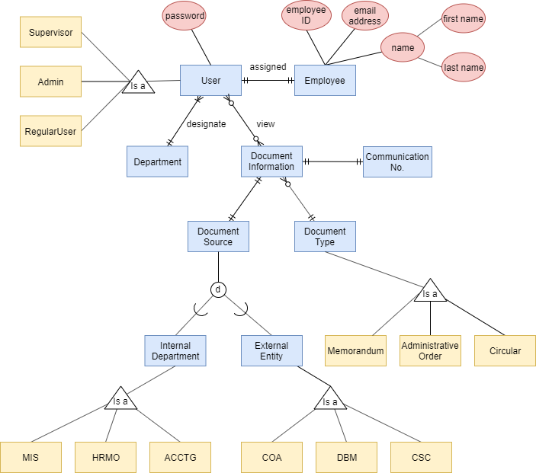
ENHANCED ENTITY-RELATIONSHIP DIAGRAM

Slide 9
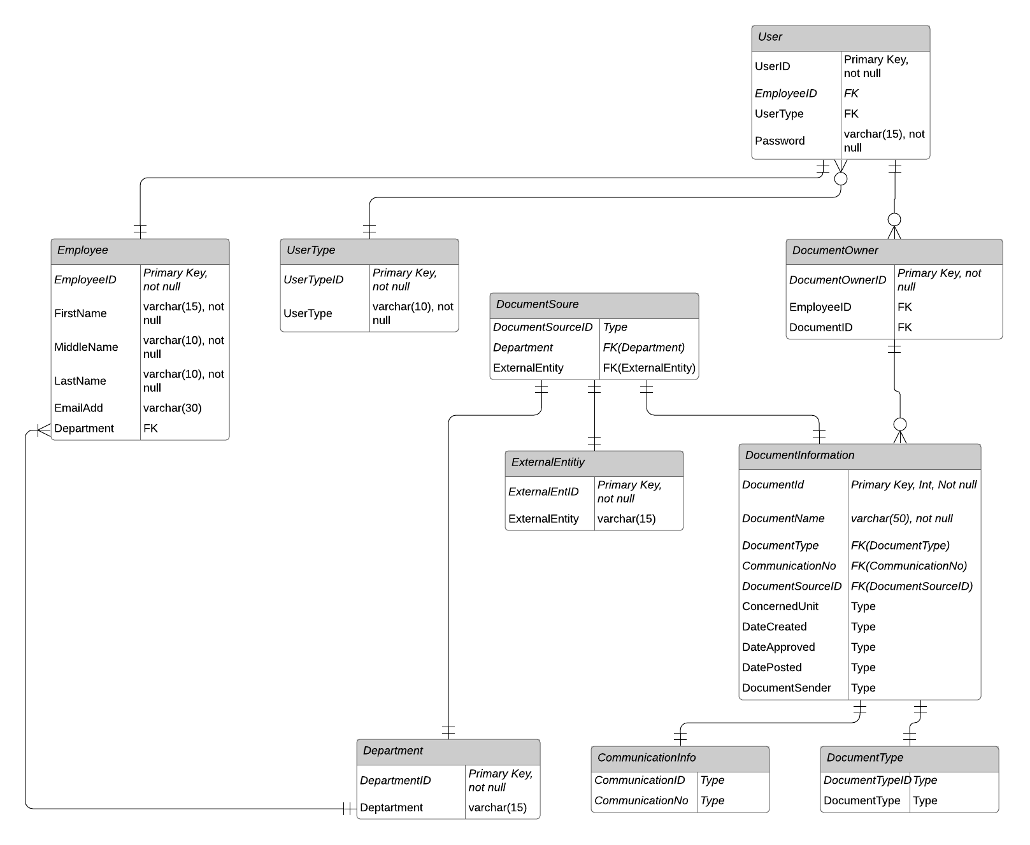
Conceptual Level

Slide 10
External View
Table | Admin | RegularUser | Supervisor
User | View user account information
UserType | Can choose user type (Admin, Supervisor, User)
Employee | View all employee information | View own information
DocumentInformation | View document information
Department | Select document source | Select department designation

Slide 11
External View
Table | Admin | RegularUser | Supervisor
DocumentType | Select document type (Memorandum, Circular, etc.) |  | Select document type (Memorandum, Circular, etc.)
CommunicationInfo | Enter communication number |  | Enter communication number

